Slide 1
Public Key Cryptography Dr. Arshad Farhad

Slide 2
Private Key Cryptography
traditional private/secret/single key cryptography uses one key
shared by both sender and receiver
if this key is disclosed communications are compromised
also is symmetric, parties are equal
hence does not protect sender from receiver forging a message & claiming is sent by sender
Notes:
2

Slide 3
Public-Key Cryptography
probably most significant advance in the 3000 year history of cryptography
uses two keys – a public & a private key
asymmetric since parties are not equal
uses clever application of number theoretic concepts to function
complements rather than replaces private key crypto
“It is insufficient to protect ourselves with laws; we need to protect ourselves with mathematics.”
-Bruce Schneier
Notes:
3
the radically different public key systems, in which two keys are used. Anyone knowing the public key can encrypt messages or verify signatures, but cannot decrypt messages or create signatures, counter-intuitive though this may seem. It works by the clever use of number theory problems that are easy one way but hard the other. Note that public key schemes are neither more secure than private key (security depends on the key size for both), nor do they replace private key schemes (they are too slow to do so), rather they complement them.

Slide 4
Public-Key Cryptography
public-key/two-key/asymmetric cryptography involves the use of two keys:
a public-key, which may be known by anybody, and can be used to encrypt messages, and verify signatures
a private-key, known only to the recipient, used to decrypt messages, and sign (create) signatures
is asymmetric because
those who encrypt messages or verify signatures cannot decrypt messages or create signatures

Slide 5
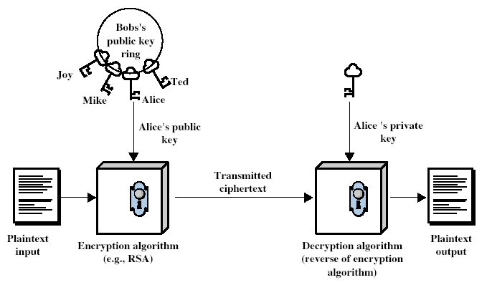
Public-Key Cryptography
Notes:
5

Slide 6
Why Public-Key Cryptography?
developed to address two key issues:
key distribution – how to have secure communications in general without having to trust a KDC with your key
digital signatures – how to verify a message comes intact from the claimed sender
Can also be used for secrecy or confidentiality for encryption/decryption
public invention due to Whitfield Diffie & Martin Hellman at Stanford Uni in 1976
known earlier in classified community
Notes:
6
The idea of public key schemes, and the first practical scheme, which was for key distribution only, was published in 1977 by Diffie & Hellman. The concept had been previously described in a classified report in 1970 by James Ellis (UK CESG) - and subsequently declassified in 1987. See History of Non-secret Encryption (at CESG). Its interesting to note that they discovered RSA first, then Diffie-Hellman, opposite to the order of public discovery!
Services (3): KDC, Signatures (user authentication and integrity)

Slide 7
Public-Key Characteristics
Public-Key algorithms rely on two keys with the characteristics that it is:
computationally infeasible to find decryption key knowing only algorithm & encryption key
computationally easy to en/decrypt messages when the relevant (en/decrypt) key is known
either of the two related keys can be used for encryption, with the other used for decryption (in some schemes)
Notes:
7
Public key schemes utilise problems that are easy (P type) one way but hard (NP type) the other way, eg exponentiation vs logs, multiplication vs factoring. Consider the following analogy using padlocked boxes: traditional schemes involve the sender putting a message in a box and locking it, sending that to the receiver, and somehow securely also sending them the key to unlock the box. The radical advance in public key schemes was to turn this around, the receiver sends an unlocked box to the sender, who puts the message in the box and locks it (easy - and having locked it cannot get at the message), and sends the locked box to the receiver who can unlock it (also easy), having the key. An attacker would have to pick the lock on the box (hard).

Slide 8
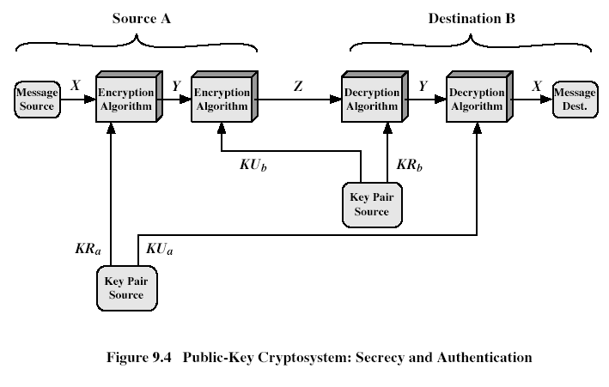
Public-Key Cryptosystems
Notes:
8

Slide 9
Security of Public Key Schemes
like private key schemes brute force exhaustive search attack is always theoretically possible
but keys used are too large (>1024bits)
security relies on a large enough difference in difficulty between easy (en/decrypt) and hard (cryptanalyse) problems
more generally the hard problem is known, its just made too hard to do in practise
requires the use of very large numbers
hence is slow compared to private key schemes
Notes:
9
Public key schemes are no more or less secure than private key schemes - in both cases the size of the key determines the security. Note also that you can't compare key sizes - a 64-bit private key scheme has very roughly similar security to a 512-bit RSA - both could be broken given sufficient resources. But with public key schemes at least there's usually a firmer theoretical basis for determining the security since its based on well-known and well studied number theory problems.

Slide 10
Public Key History
Some algorithms
Diffie-Hellman, 1976, key-exchange based on discrete logs
Merkle-Hellman, 1978, based on “knapsack problem”
McEliece, 1978, based on algebraic coding theory
RSA, 1978, based on factoring
Rabin, 1979, security can be reduced to factoring
ElGamal, 1985, based on discrete logs
Blum-Goldwasser, 1985, based on quadratic residues
Elliptic curves, 1985, discrete logs over Elliptic curves
Chor-Rivest, 1988, based on knapsack problem
NTRU, 1996, based on Lattices
XTR, 2000, based on discrete logs of a particular field

Slide 11
Discrete Logarithm
In mathematics, a discrete logarithm is an integer k solving the equation b^{k} = g, where b and g are elements of a group.
For example, consider the equation 3^{k} ≡ 13 (mod 17) for k. From the example above, one solution is k = 4, but it is not the only solution.
Ordinary logarithms, solve the same equation for real numbers b and g, where b is the base of the logarithm and g is the value whose logarithm is being taken.
Computing discrete logarithms is believed to be difficult. No efficient general method for computing discrete logarithms on conventional computers is known
Several important algorithms in public-key cryptography base their security on the assumption that the discrete logarithm problem has no efficient solution.

Slide 12
Diffie-Hellman Key Exchange
first public-key type scheme proposed
by Diffie & Hellman in 1976 along with the exposition of public key concepts
note: now know that Williamson (UK CESG) secretly proposed the concept in 1970
is a practical method for public exchange of a secret key
used in a number of commercial products
Notes:
This chapter continues our overview of public-key cryptography systems (PKCSs), and begins with a description of one of the earliest and simplest PKCS, Diffie-Hellman key exchange. This first published public-key algorithm appeared in the seminal paper by Diffie and Hellman that defined public-key cryptography [DIFF76b] and is generally referred to as Diffie-Hellman key exchange. The concept had been previously described in a classified report in 1970 by Williamson (UK CESG) - and subsequently declassified in 1987, see [ELLI99]. The purpose of the algorithm is to enable two users to securely exchange a key that can then be used for subsequent encryption of messages. The algorithm itself is limited to the exchange of secret values. A number of commercial products employ this key exchange technique.

Slide 13
Diffie-Hellman Key Exchange
a public-key distribution scheme
cannot be used to exchange an arbitrary message
rather it can establish a common key
known only to the two participants
value of key depends on the participants (and their private and public key information)
Notes:
The purpose of the algorithm is to enable two users to securely exchange a key that can then be used for subsequent encryption of messages. The algorithm itself is limited to the exchange of secret values, which depends on the value of the public/private keys of the participants. The Diffie-Hellman algorithm uses exponentiation in a finite (Galois) field (modulo a prime or a polynomial), and depends for its effectiveness on the difficulty of computing discrete logarithms.

Slide 14
Diffie-Hellman Setup
all users agree on global parameters:
large prime integer q
a being a primitive value w.r.t q
each user (eg. A) generates their key
chooses a secret key (number): x_{A} < q
compute their public key: y_{A} = a^{xA} mod q
each user makes public that key y_{A}
Notes:
In the Diffie-Hellman key exchange algorithm, there are two publicly known numbers: a prime number q and an integer a that is a primitive root of q. The prime q and primitive root a can be common to all using some instance of the D-H scheme. Note that the primitive root a is a number whose powers successively generate all the elements mod q. Users Alice and Bob choose random secrets x's, and then "protect" them using exponentiation to create their public y's. For an attacker monitoring the exchange of the y's to recover either of the x's, they'd need to solve the discrete logarithm problem, which is hard.

Slide 15
Diffie-Hellman Key Exchange
shared session key for users A & B is K_{AB}:
K_{AB} = a^{xA.xB} mod q
= y_{A}^{xB} mod q (which B can compute)
= y_{B}^{xA} mod q (which A can compute)
K_{AB} is used as session key in private-key encryption scheme between Alice and Bob
if Alice and Bob subsequently communicate, they will have the same key as before, unless they choose new public-keys
attacker needs an x, must solve discrete log
Notes:
The actual key exchange for either party consists of raising the others "public key' to power of their private key. The resulting number (or as much of as is necessary) is used as the key for a block cipher or other private key scheme. For an attacker to obtain the same value they need at least one of the secret numbers, which means solving a discrete log, which is computationally infeasible given large enough numbers. Note that if Alice and Bob subsequently communicate, they will have the same key as before, unless they choose new public-keys.

Slide 16


Diffie-Hellman Key Exchange
Alice A
Public Parameters:
large prime q
primitive root a
Bob
B
Choose a secret X_{A}
Compute Y_{A} = a^{XA} mod q
Send Y_{A}
Choose a secret X_{B}
Compute Y_{B} = a^{XB} mod q
Send Y_{B}
Shared Key
K_{AB} = Y_{B} ^{XA}
= a ^{XBXA} mod q
Nobody can calculate k given
q, a, Y_{A}, and Y_{B}
Shared Key
K_{AB} = Y_{A} ^{X}B
= a ^{XAXB} mod q

Slide 17
Diffie-Hellman Example
users Alice & Bob who wish to swap keys:
agree on prime q=353 and a=3
select random secret keys:
A chooses x_{A}=97, B chooses x_{B}=233
compute respective public keys:
y_{A}=3⁹⁷ mod 353 = 40 (Alice)
y_{B}=3²³³ mod 353 = 248 (Bob)
compute shared session key as:
K_{AB}= y_{B}^{xA} mod 353 = 248⁹⁷ = 160 (Alice)
K_{AB}= y_{A}^{xB} mod 353 = 40²³³ = 160 (Bob)
Notes:
Here is an example of Diffie-Hellman from the text using prime q=353, showing how each computes its public key, and then how after they exchange public keys, each can compute the common secret key.I n this simple example, it would be possible by brute force to determine the secret key 160. In particular, an attacker E can determine the common key by discovering a solution to the equation 3ª mod 353 = 40 or the equation 3^{b} mod 353 = 248. The brute-force approach is to calculate powers of 3 modulo 353, stopping when the result equals either 40 or 248. The desired answer is reached with the exponent value of 97, which provides 3⁹⁷ mod 353 = 40. With larger numbers, the problem becomes impractical.

Slide 18
primitive roots
Let p be a prime. Then b is a primitive root for p if the powers of b,
1, b, b^2, b^3, ...
include all of the residue classes mod p (except 0).
Since there are p-1 residue classes mod p (not counting 0), the first p-1 powers of b must be different mod p.
We have noticed that the powers of b form a repeating cycle, and that cycle can't be longer than p-1 (because of Fermat's Little Theorem). So, b is a primitive root if the cycle is as long as it can possibly be.

Slide 19
primitive roots
Examples: If p=7, then 3 is a primitive root for p because the powers of 3 are 1, 3, 2, 6, 4, 5---that is, every number mod 7 occurs except 0. But 2 isn't a primitive root because the powers of 2 are 1, 2, 4, 1, 2, 4, 1, 2, 4...missing several values.
Example: If p=13, then 2 ?
is a primitive root because the powers of 2 are
1, 2, 4, 8, 3, 6, 12, 11, 9, 5, 10, 7---which is all of the classes mod 13 except 0. There are other primitive roots for 13.

Slide 20
primitive roots
Theorem: If p is a prime, then there is a primitive root for p.
(In fact, if p is a prime and p>2, there are always at least two primitive roots, and sometimes many more.)
How to find a primitive root for p? Just try possibilities, starting with 2, 3, ..., until you find one that works.

